Slide 1
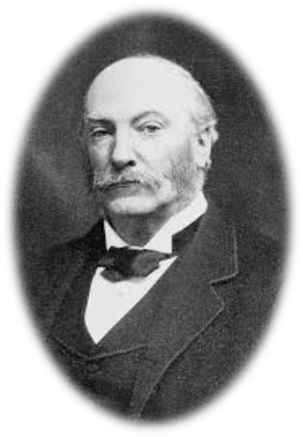
Lecture 24
Chemical Engineering for Micro/Nano Fabrication

Slide 2


Final Exam
When: Thursday December 13th from 9:00 am – Noon
Where: ETC 2.114
Bring Pencil, eraser....no calculator.
Corrected Exams will be available for you in NHB 5.136 after the grades are posted.

Slide 3
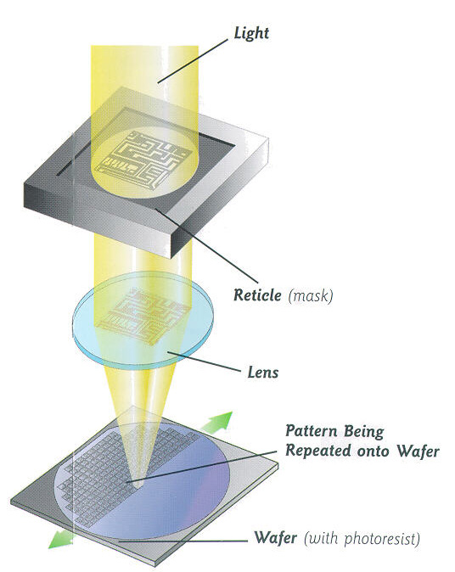
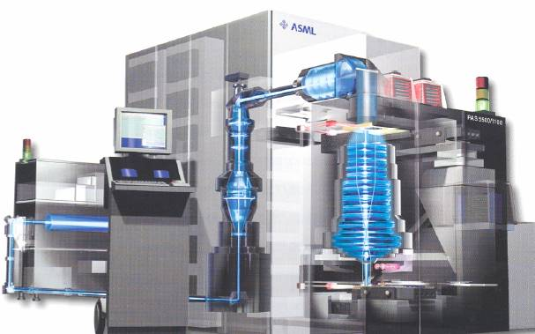
Exposure Systems
“Steppers and Scanners”
λ
R= k
NA

Slide 4
Optical Lithography Limits
R = minimum feature size, l = wavelength
n = refractive index, θ = capture angle of lens
n = 1.44 (Water)
k₁ = 0.3
λ = 193 nm
sinθ = 0.9
R = 45 nm

Slide 5
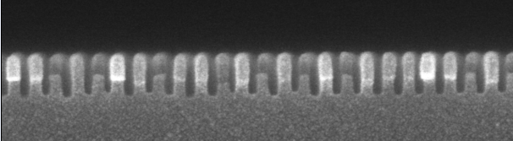

Only option is double exposure?
20nm lines and spaces
+
=

Slide 6

$ ₩ ¥ € !
SADP
can it be cheaper?

Slide 7
Breaking Rayleigh's Rule

Slide 8
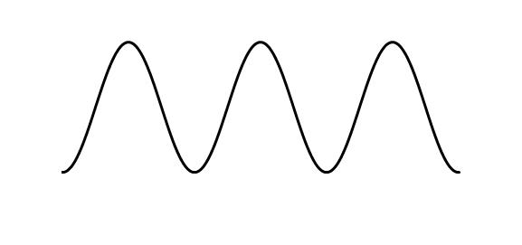
How to achieve pitch division
Conventional Resist System
Pitch Division Approach
Mask
Mask
E₀
E_{n}
Aerial Image
Aerial Image
E₀
Resist
Profile
Resist
Profile
P
N
The frequency on the wafer plane is SAME as that on the mask.
One space on the mask prints TWO spaces on the wafer plane.

Slide 9
Soluble
E_{o}
Dissolution Threshold Dose
Insoluble
Threshold like Response of ArF Resist
E_{o}

Slide 10
Dual-tone resist
Insoluble
Dissolution Threshold, E_{n}
Dissolution Threshold, E_{o}
Soluble
Insoluble
P
N
P
N
P
N
P

Slide 11
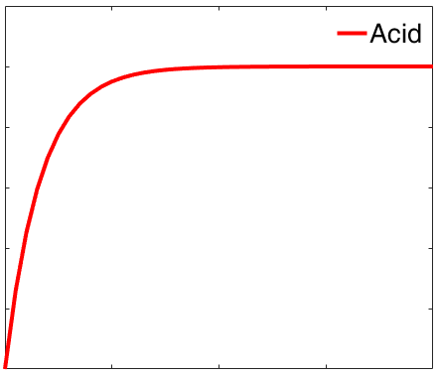
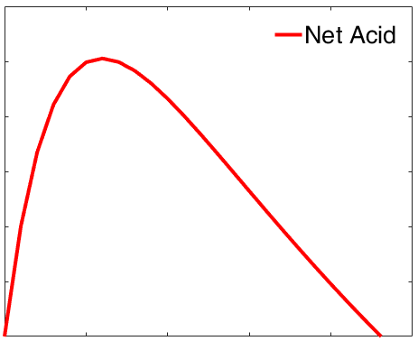
How do we introduce another threshold?
Conventional Resist
Pitch Division Resist
Soluble
Add Base!!
[Acid]
[Acid]
Threshold Acid
Concentration
Insoluble
Dose
Dose
Film Thickness
Film Thickness
Film Thickness
E₀
Dose
E₀
Dose
E_{n}
Adapted from 2018 Prelim Talk_Ji Yeon Kim

Slide 12
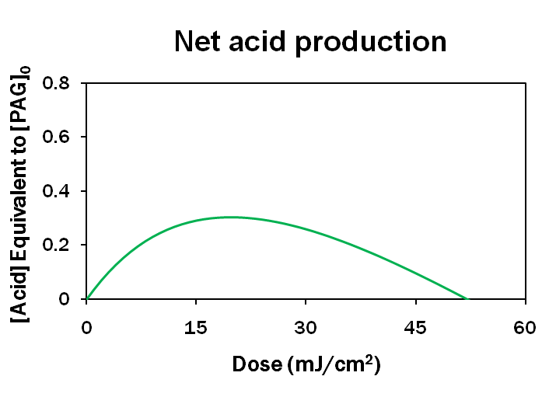
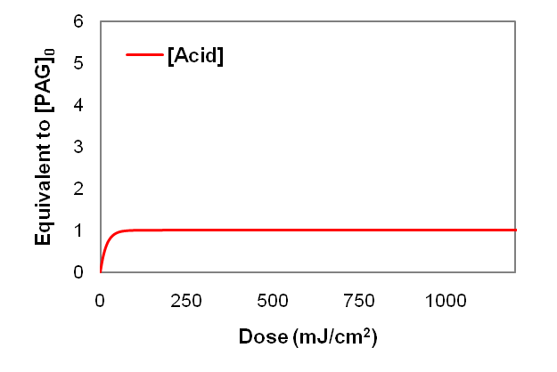
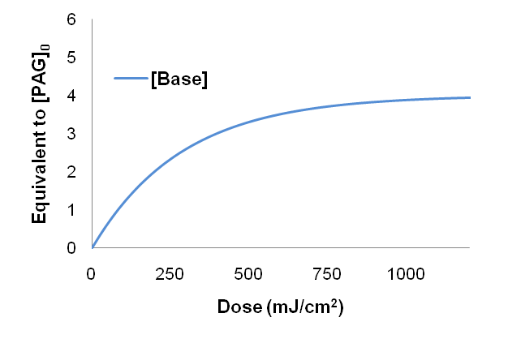
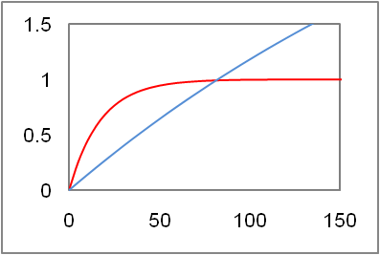
Photoactive System And Mechanism
k_{a}
PAG
Acid
Net Acid
Salt (Inert)
Base
hv
hv
k_{b}
Photobase generator
(PBG)
[PBG]₀ > [PAG]₀
k_{b} < k_{a}
Notes:
So how do we achieve the near-parabolic acid profile? Use base!

Slide 13
Photobase Generator (PBG)
DIPA-CARB
Suyama et al., Progress in Polymer Science, 34 (2009) 194-209.
Houlihan et al., Macromolecules, 21 (1988) 2001-2006.
Cameron et al., J. Am. Chem. Soc., 113 (1991) 4303-4313.
Notes:
Nitrobenzyl group?

Slide 14

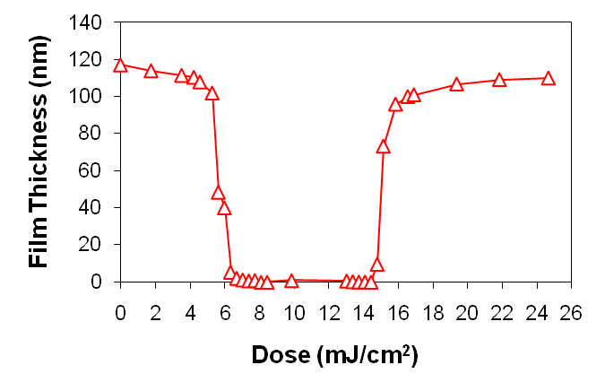
A Test Formulation
Photoacid generator (PAG)
Photobase generator
(PBG)
MAdMA:GBLMA (50/50)
CONDITIONS:
6.5 wt% of PAG to polymer
PBG/PAG molar ratio = 3
PEB: 121.5 ºC, 60 sec
BARC (89 nm)
E₀
E_{n}
f

Slide 15
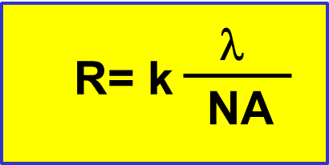
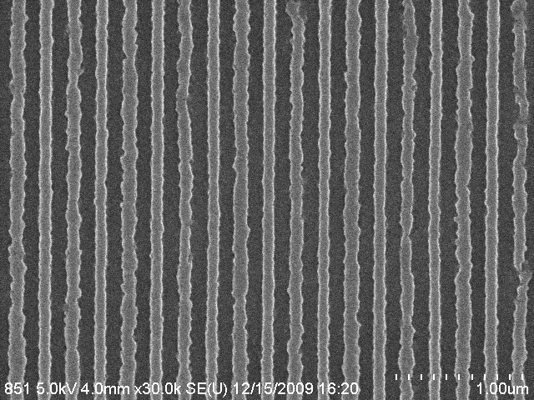
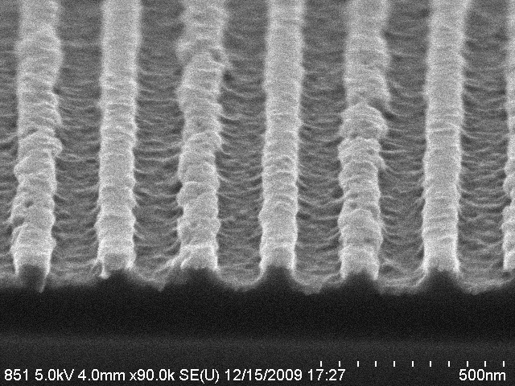

Lithography Result
k₁ = 0.15!!!
DCHA-CARB
NA = 0.22, 440 nm pitch aerial image
220 nm pitch
220 nm pitch
Notes:
Rough LER every alternate line

Slide 16
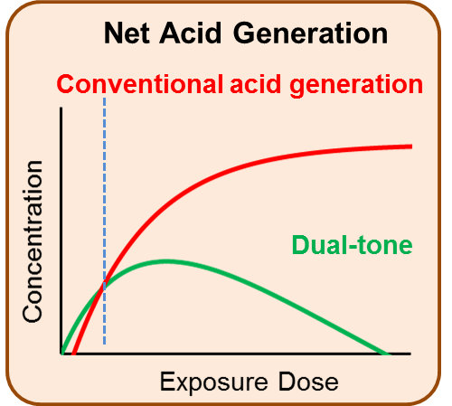
Low chemical contrast

Slide 17
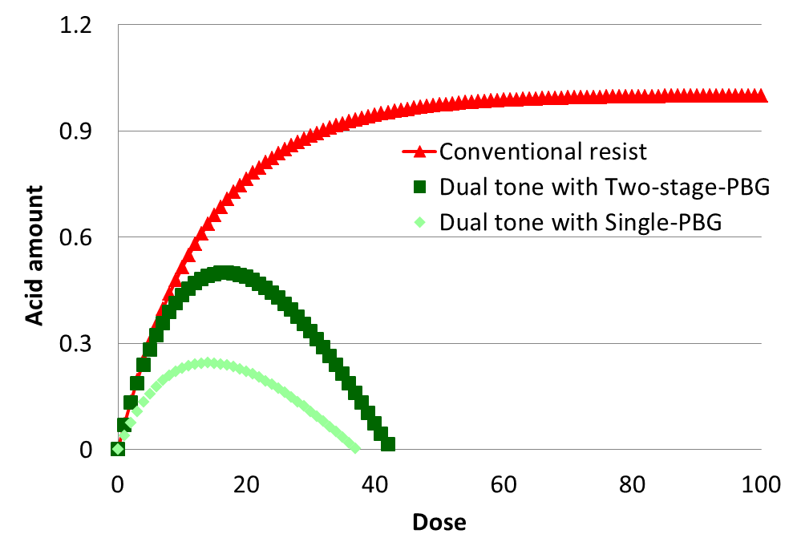
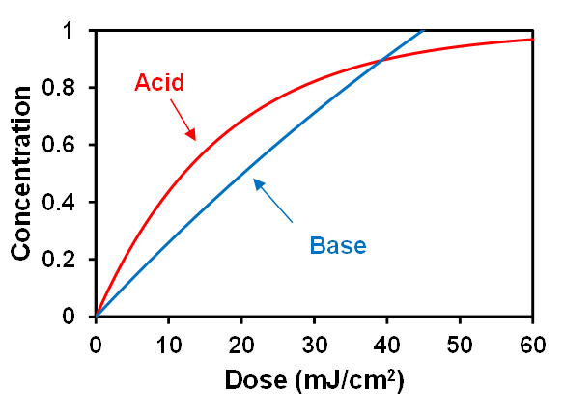
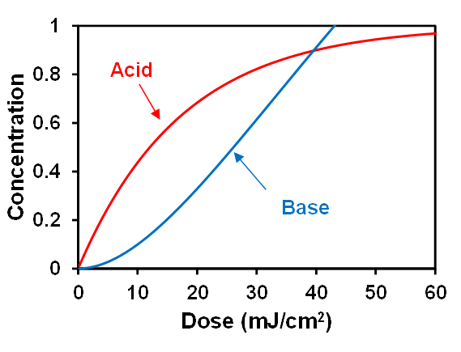
Increasing Chemical Contrast (Acid Gradient)
Conventional PBG
2-Stage PBG
2-Stage PBG improves chemical contrast!!
With Nick Turro from Columbia

Slide 18
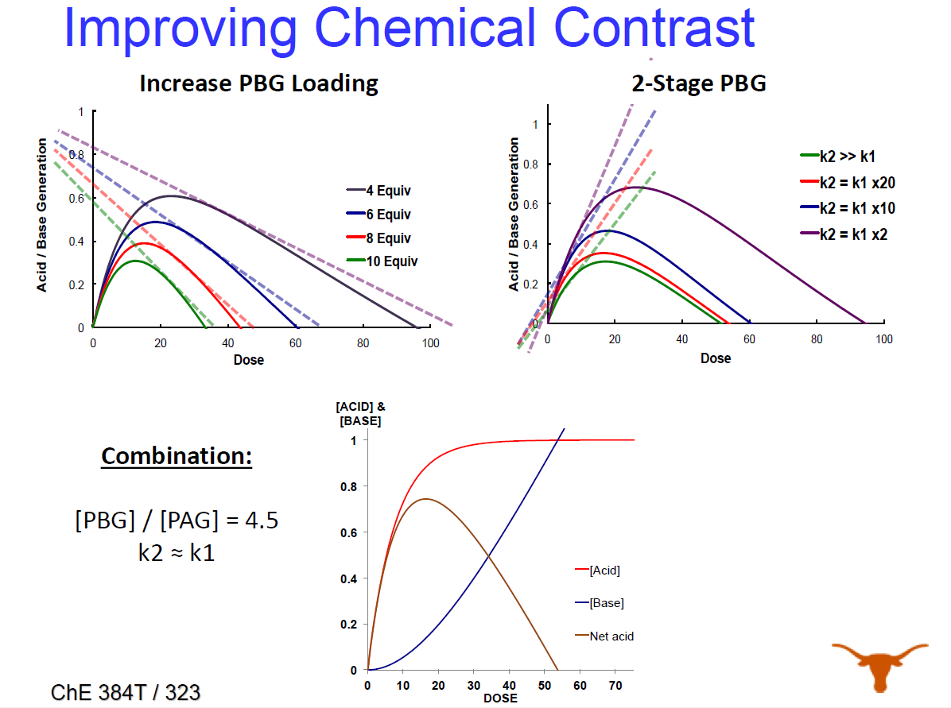

Slide 19
Photo-aromatization type 2-stage PBGs
Enol
Norrish II
Step 1
Latent PBG
PBG
keto
hν
Step 2
base
base

Slide 20
Contrast curve under 193nm
Normalized Thickness remaining
mJ / cm²

Slide 21
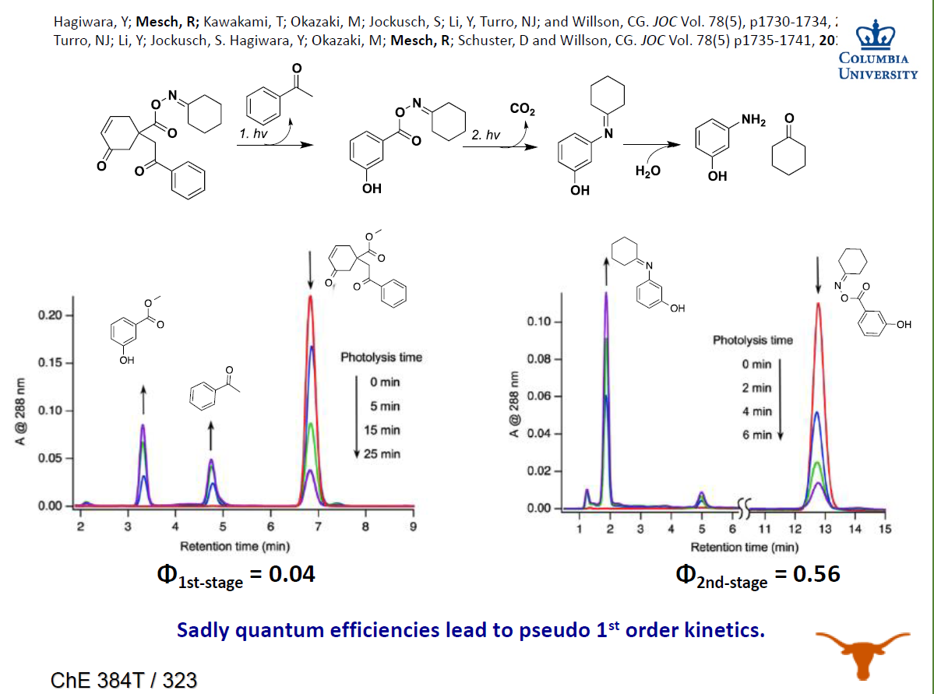

Slide 22
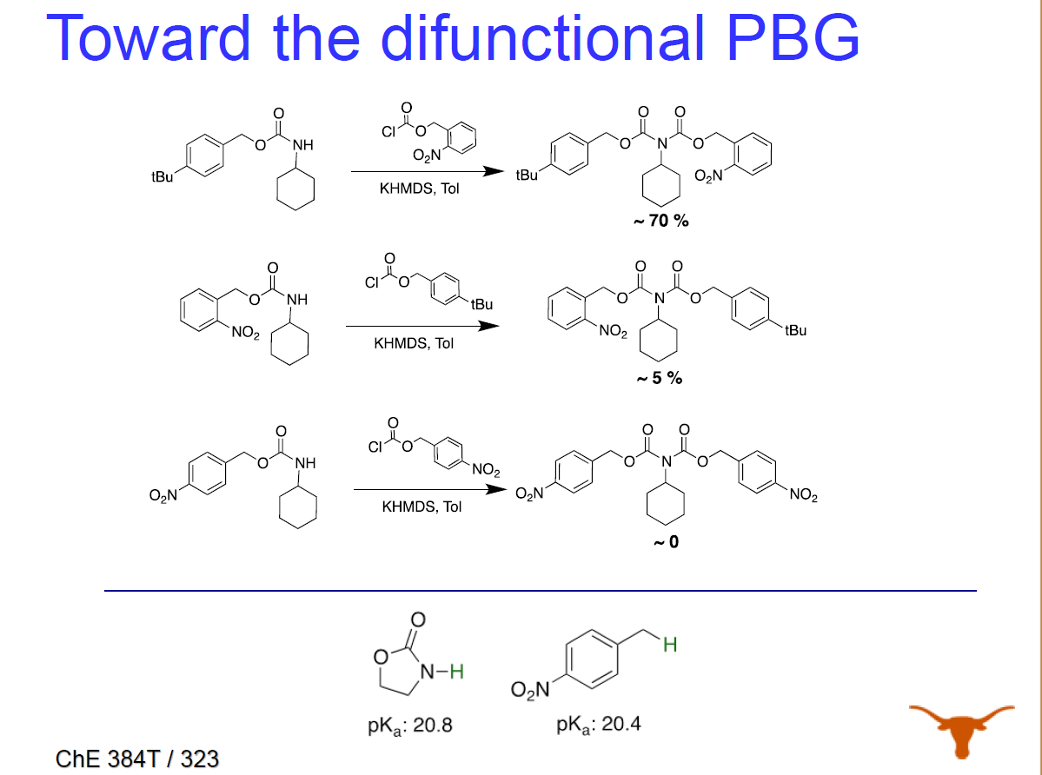

Slide 23
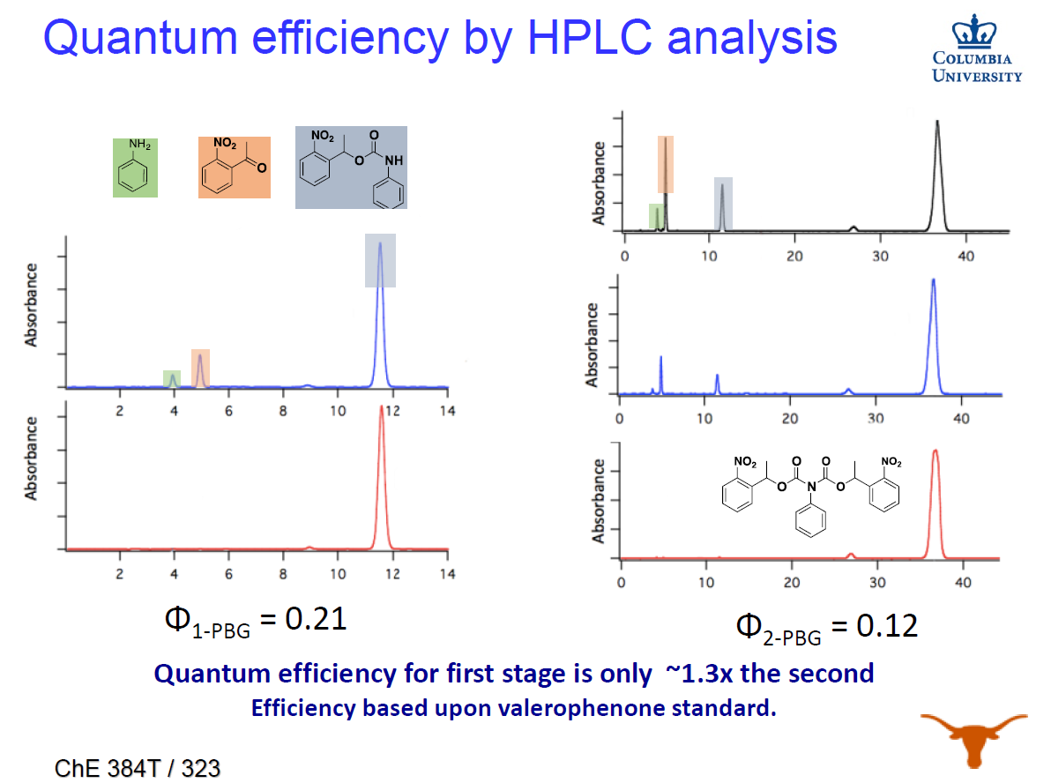

Slide 24
More Recent Results
Nonlinear!!

Slide 25
Demonstration with IBM
CHA-NO2
CHA-bisNO2
1-Stage Cross Section
2-Stage Cross Section
Notes:
Solve the LER issue

Slide 26
Demonstration with IBM
193
Notes:
Much improved LER

Slide 27
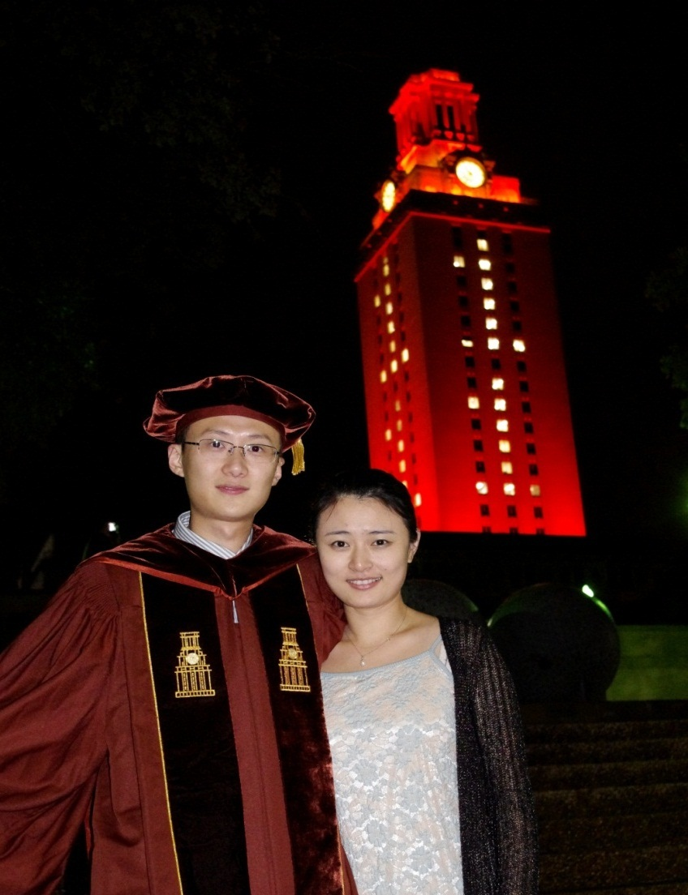

Will this work???
Great students are working hard
Time will tell!!
Dr. Xinyu Gu

Slide 28
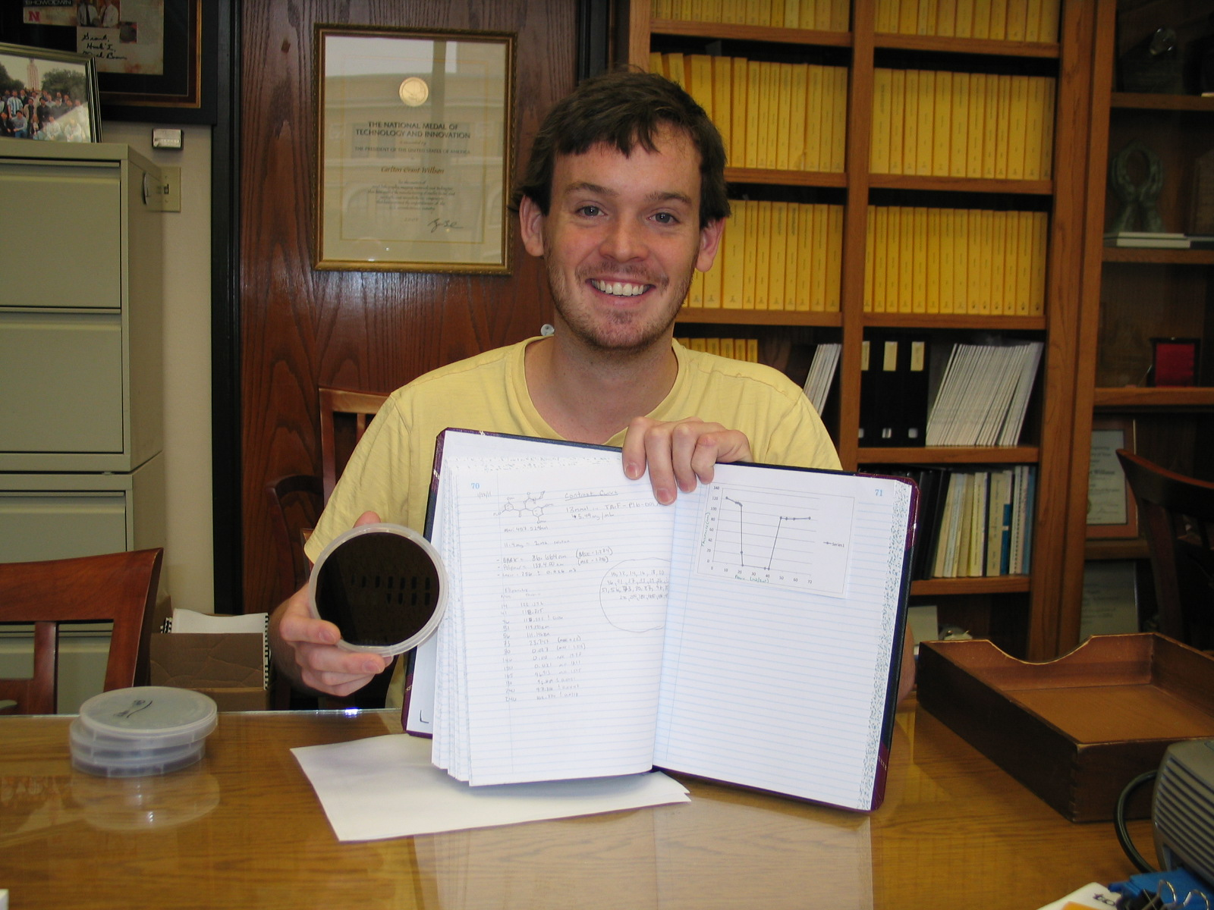
Ryan Mesch

Slide 29
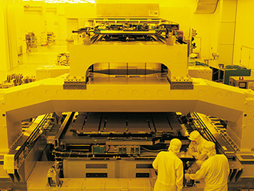



Shifting to longer wavelength (365 nm λ)
I-line Flat Panel Lithography Tool
Oh no…I don’t want to buy this again
Image from Canon,
https://www.mysmarttvs.co.uk/products/samsung-ue55ks9000-smart-4k-ultra-hd-hdr-55-curved-led-tv

Slide 30
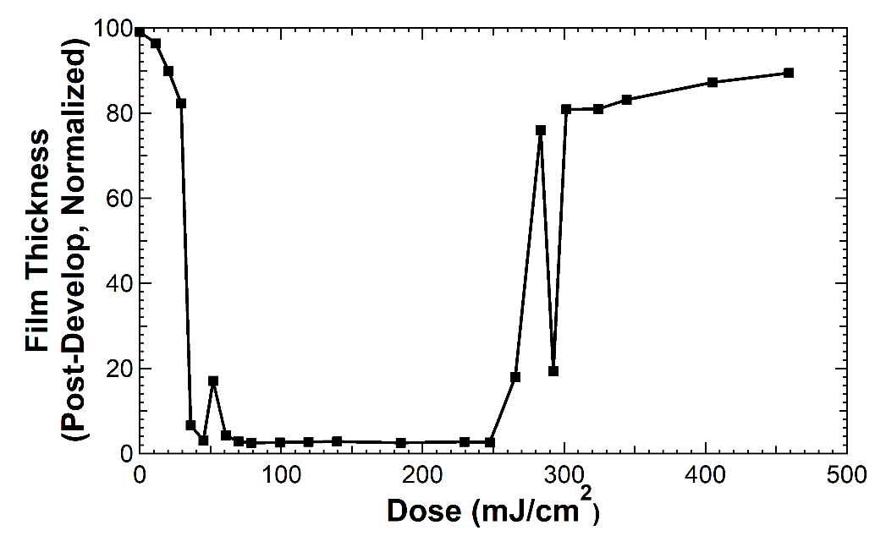
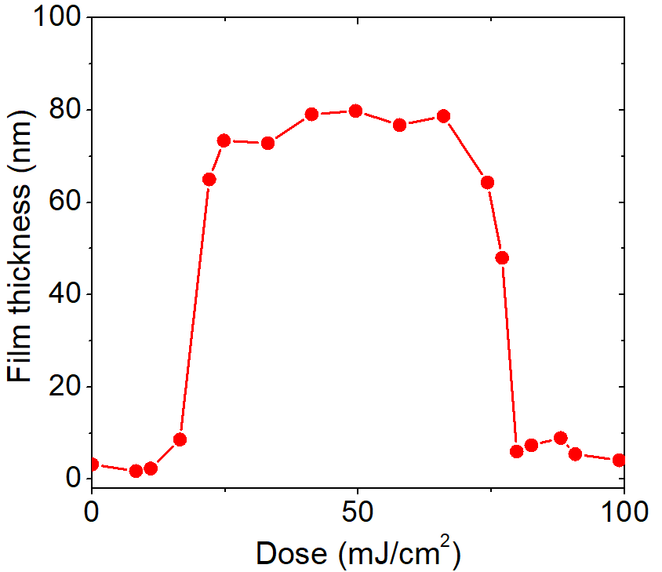
Pitch division at i-line (365 nm λ)
Positive Tone Resist
Negative Tone Resist
Early proof of concept by Paul Meyer and Cameron Adams
Early proof of concept by
Ji Yeon Kim

Slide 31

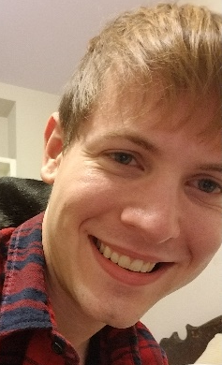
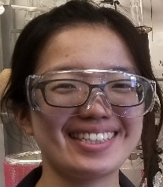

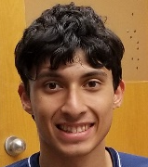
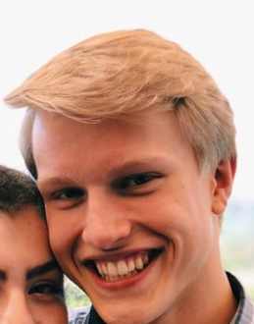

The I-liners
Paul Meyer
Patrick Harold
Daniel Bonnecaze
Cameron Adams
Ji Yeon Kim

Slide 32
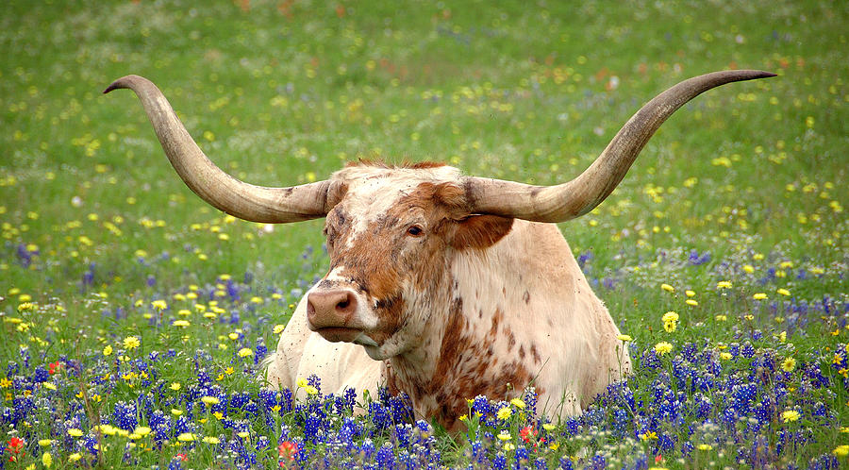
Thank you!!

